Slide 1

UNIVERSITY INSTITUTE OF ENGINEERING
COMPUTER SCIENCE ENGINEERING
Bachelor of Engineering (Computer Science & Engineering)
Subject Name: Big Data Analytics
Subject Code: 20CST-471
Prescriptive Analytics
Mapped with CO4
Prepared By:
Er. Ankita Sharma
DISCOVER . LEARN . EMPOWER

Slide 2
Prescriptive analytics
Prescriptive analytics is the advanced stage of analytics that goes beyond descriptive and predictive analytics to recommend specific actions that can optimize decision-making processes. While descriptive analytics explains what has happened, predictive analytics forecasts what might happen, prescriptive analytics takes it a step further by suggesting the best course of action to achieve a desired outcome.

Slide 3
Key Characteristics of Prescriptive Analytics:
Optimization Focus:
The primary goal of prescriptive analytics is to optimize decisions and outcomes. It helps organizations determine the best actions to take in order to achieve specific objectives or maximize desired outcomes.
Recommendation of Actions:
Instead of merely providing insights or predictions, prescriptive analytics recommends specific actions or strategies that can be taken to improve performance, reduce costs, increase efficiency, or achieve other business goals.
Incorporates What-If Analysis:
Prescriptive analytics often involves "what-if" analysis, allowing decision-makers to explore various scenarios and understand the potential impact of different actions before making a decision.

Slide 4
Utilizes Machine Learning and Optimization Algorithms:
Advanced machine learning algorithms and optimization techniques are commonly used in prescriptive analytics. These algorithms consider multiple variables, constraints, and objectives to recommend the best possible actions.
Real-Time Decision Support:
In some applications, prescriptive analytics operates in real-time, providing decision-makers with immediate insights and recommendations as new data becomes available.
Feedback Loop:
Prescriptive analytics systems often include feedback loops, allowing organizations to continuously learn and refine their decision-making processes based on the outcomes of previous decisions.

Slide 5
Use Cases of Prescriptive Analytics:
Supply Chain Optimization:
Determining the optimal inventory levels, production schedules, and distribution strategies to meet customer demand while minimizing costs.
Financial Portfolio Management:
Recommending specific investment strategies or adjusting asset allocations to maximize returns while managing risks based on market conditions.
Dynamic Pricing Strategies:
Recommending pricing adjustments in real-time based on factors such as demand, competitor pricing, and market conditions.

Slide 6
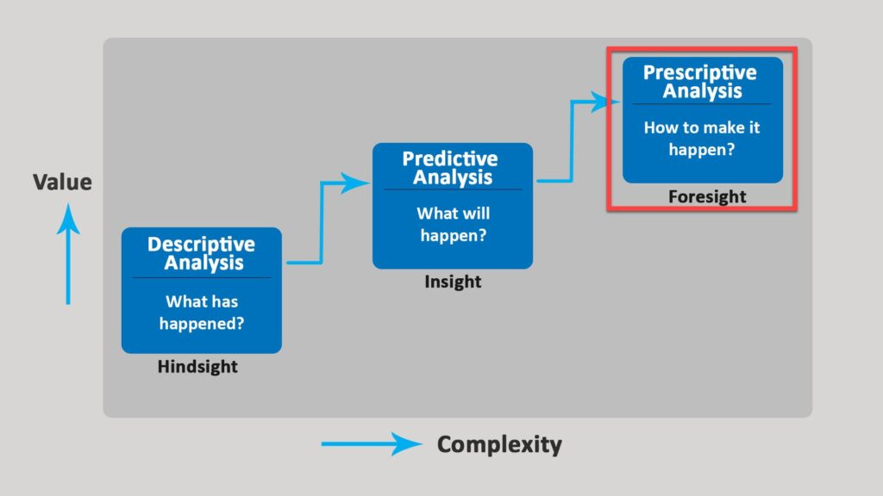

Slide 7
Healthcare Treatment Plans:
Recommending personalized treatment plans for patients based on their medical history, genetic information, and responses to previous treatments.
Energy Grid Management:
Optimizing the operation of energy grids by recommending adjustments in real-time to balance supply and demand and prevent disruptions.
Marketing Campaign Optimization:
Recommending the most effective marketing strategies and channels to maximize the impact of campaigns and achieve specific business objectives.

Slide 8
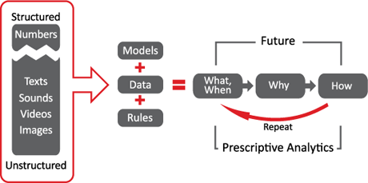

Slide 9
Benefits of Prescriptive Analytics:
Precision in Decision-Making:
Prescriptive analytics provides precise recommendations, helping organizations make decisions that align with their strategic goals.
Efficiency and Cost Savings:
By recommending optimal actions and strategies, prescriptive analytics can lead to increased operational efficiency and cost savings.
Competitive Advantage:
Organizations that effectively leverage prescriptive analytics gain a competitive advantage by making more informed and optimized decisions compared to competitors.
Adaptability to Changing Conditions:
The ability to conduct real-time analysis and adjust recommendations allows organizations to adapt quickly to changing market conditions.

Slide 10
Thankyou

